Slide 1
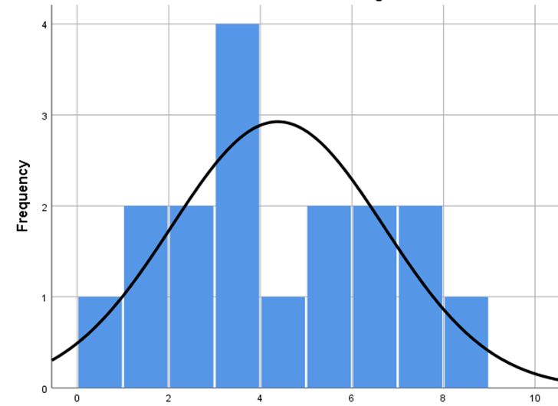
A
B
C
D
Supplemental Figure 2. Testing whether mutation values are normally distributed. The raw father-son nucleotide differences (mutations) were tested for normality via histogram plots (A), (B) and via Q-Q plots (C), (D). Both the raw (A), (C) nucleotide differences (to several decimal places) and the rounded (B), (D) nucleotide differences (rounded to the ones place) were tested.

